Slide 1
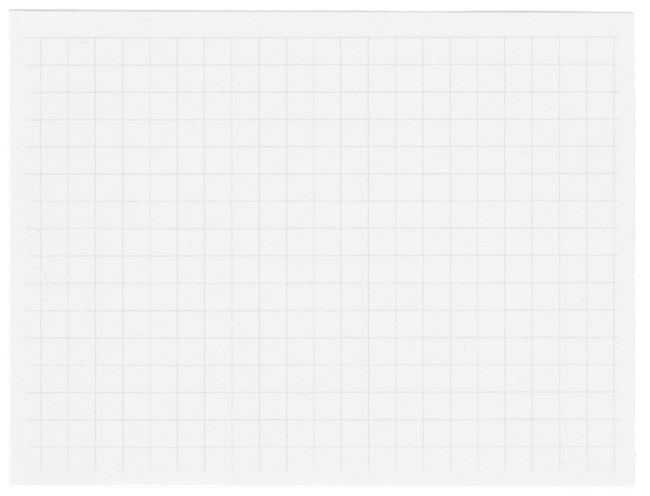
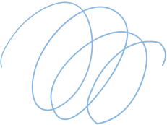


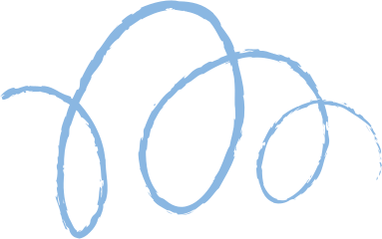








Clustering of
Social Media Usage
Presented by Fahimul Alam

Slide 2

Objectives
To identify user segments based on their social media presence using clustering techniques
To extract actionable insights from the data

Slide 3
Standardized inconsistent entries in 'Primary Social Media Platform' and 'Frequency of Posting'
01.
Data Preprocessing
Converted categorical features ('Frequency of Posting', 'Academic Performance', 'Primary Social Media Platform') to numerical format.
02.
03.
Standardized the 'Number of Friends or Followers' column to have a mean of 0 and standard deviation of 1

Slide 4
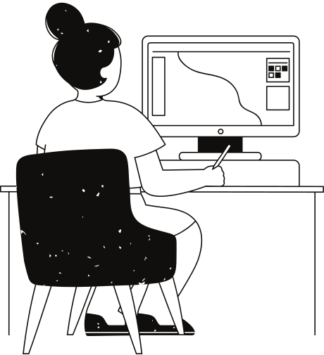
EDA
A noticeable concentration of users around 25 years of age
Daily Social Media Usage: An average of around 3 hours per day.
Social media usage tends to increase with number of friends/followers, but the correlation is not very strong
Pair plots didn't reveal clear patterns in the interactions between numerical features.

Slide 5
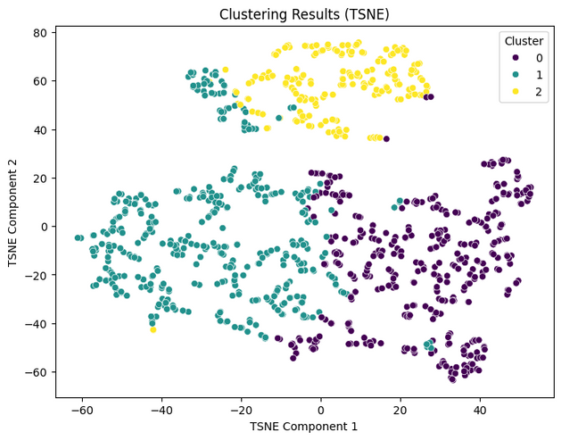
Model Development and Evaluation
The K-Means algorithm was applied to group the data points into 3 clusters using a range of features
A silhouette score was calculated to check the quality of clusters
traffic, and mode of transportation are important factors when predicting commute time.
Silhouette Score : 0.256

Slide 6
Key Takeaways
&
Recommendations
Major Points
Suggestions
Data cleaning and preprocessing is essential for data quality and reliability
Initial EDA provides basic insights into the distributions and correlations of variable
The current dataset lacks the clear patterns or strong relationships necessary for the effective use of K-Means clustering
Modularize the system
Explore non-linear models
Collect more data

Slide 7
Thank you very much!

